Slide 1

Food Saver +
Save Money Shopping
Harsha Palacherla, Joseph Sumlin, Mikail Alli, Yuvraj Goyal

Slide 2
What is Food Saver+

Slide 3
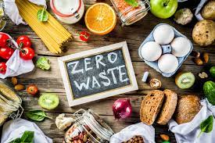
Food Saver + is a website that users can visit to view cheap and discounted goods to purchase at partnered grocery stores.
We aim to reduce food waste by connecting users to nearby stores where items are close to their sell date.

Slide 4
Our Purpose

Slide 5
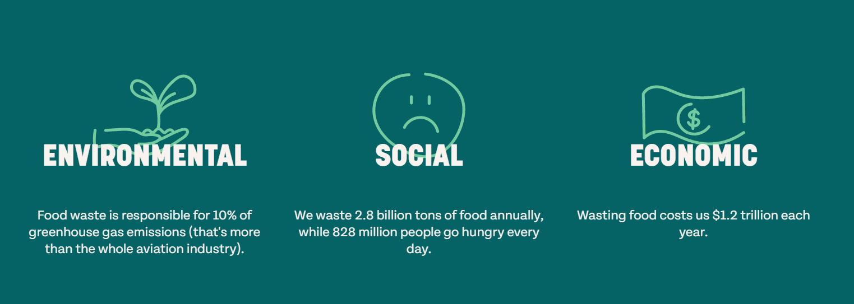

Slide 6
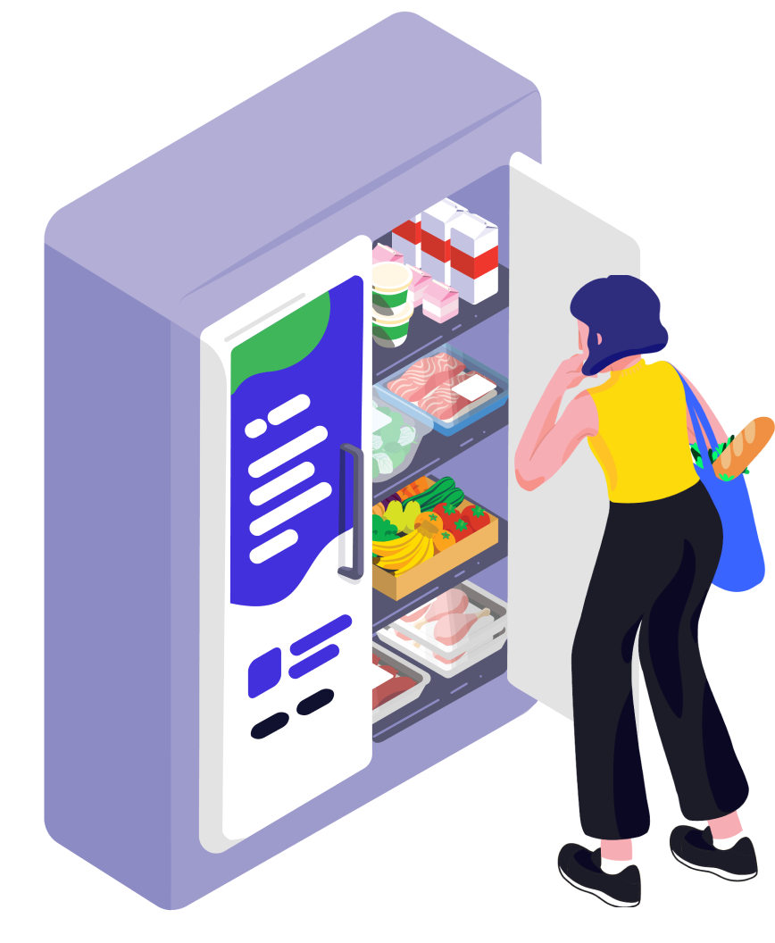
Key functionality
Reserve food items (through the Kiosk/FS+ zone)
Recipe suggestions for item
Store sign up

Slide 7
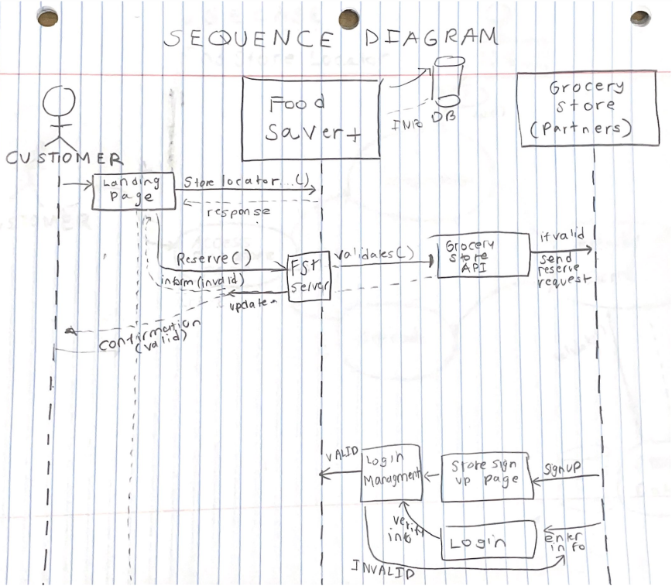
UML Sequence Diagram

Slide 8
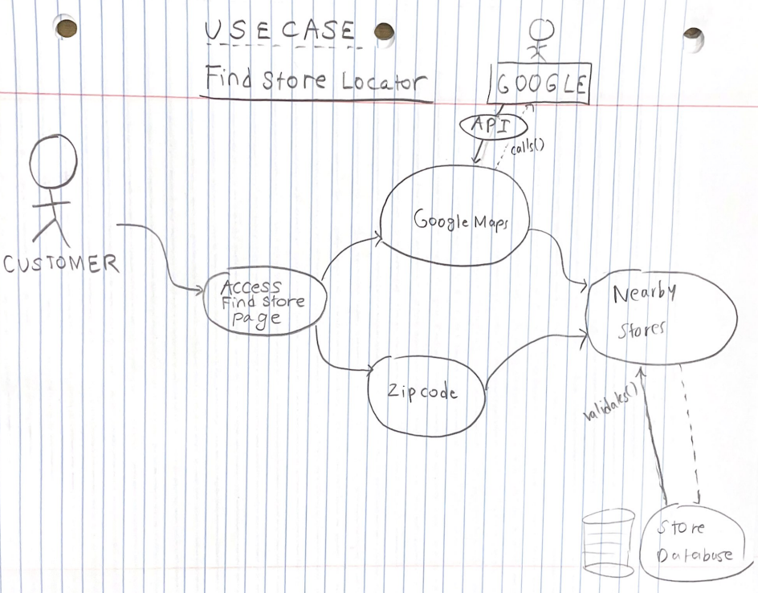
Use Case #1 - Store Locator

Slide 9
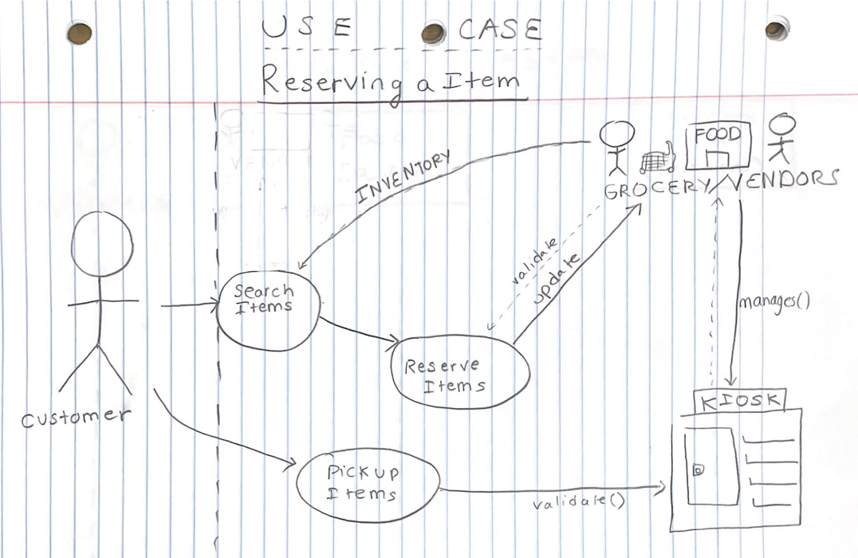
Use Case #2 - Reserve an Item

Slide 10
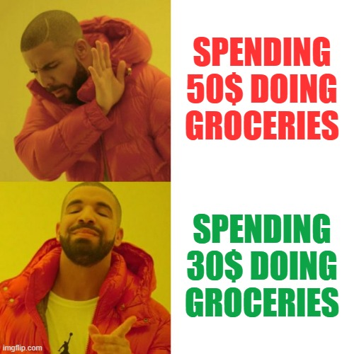
Target Users
Anybody that wants to save MONEY!

Slide 11



Chosen Technologies
Front-end: React, JavaScript, HTML/CSS
Back-end: MySQL
Middle layer: Flask

